Slide 1
NAP4
Fibreoptic Intubation
Use & Omissions

Slide 2
Recommendations
All anaesthetic departments should provide a service where the skills and equipment are available to deliver awake fibreoptic intubation whenever it is indicated

Slide 3
Recommendations
Where FOI is thought to be the optimal method of securing the airway, an awake technique should be considered unless it is contraindicated

Slide 4
Recommendations
Where complex sedation techniques are to be used, strong consideration should be given to delegating the provision of sedation to an anaesthetist not performing the intubation

Slide 5
Recommendations
Following AFOI, general anaesthesia should only be induced after the tube has been railroaded and its position has been checked (and the cuff has been inflated)

Slide 6
Recommendations
AFOI may fail. A back up plan should always be worked out in advance

Slide 7
Recommendations
Oral FOI should be taught and practised alongside nasal FOI.
The oral route should be considered in patients where the nasal route is not specifically indicated

Slide 8
Recommendations
All anaesthetists should be trained in low-skill fibreoptic intubation through a supraglottic airway

Slide 9
Recommendations
Fibreoptic endoscopy should be immediately available to confirm airway device placement in situations where capnography may be misinterpreted

Slide 10
Fibreoptic Intubation Headlines
It fails
Over-sedation was a problem
Failure to employ = largest problem

Slide 11
Fibreoptic Intubation Headlines
It fails
Over-sedation was a problem
Failure to consider = largest problem
We should decrease the threshold for choosing AFOI
We need departmental solutions to the provision of AFOI 24/7

Slide 12
Fibreoptic Intubation “What we know already”
CEPOD 1998 (Departmental Solutions)
Asai 2004 (Railroading fails)
Ho 2004 (LA Total obstruction risk)
DAS 2004 (Use low skill techniques)
Liverpool 2006 (Sedation can cause problems)

Slide 13
Fibreoptic Intubation “What’s new”

Slide 14
Fibreoptic Intubation “What’s new”
Failure to use awake FOI (18 cases) was associated with failed intubation in 16 cases. Two of these developed hypoxic cardiac arrest

Slide 15
Failure to use AFOI (example)
ASA2, OSA, tracheal deviation
SV, Propofol & Remifentanil
Direct laryngoscopy, Grade 3 view
Complete airway obstruction
Narrow & Wide bore cric failed
SpO2 < 50% for 20 minutes
Difficult tracheostomy
Ventilated on ICU for cerebral hypoxia

Slide 16
Fibreoptic Intubation “What’s new”
Failure to use awake FOI
Confirmation of Airway device placement

Slide 17
Unsuccessful resuscitation following cardiac arrest in an ICU patient (no capnography)
Fibreoptic examination after death confirmed the tube was in the oesophagus

Slide 18
Several ICU cases with tracheostomy problems
No endoscopic examination at the time
Subsequent emergency when tracheostomies became completely displaced

Slide 19
Fibreoptic Intubation “Other cases”

Slide 20
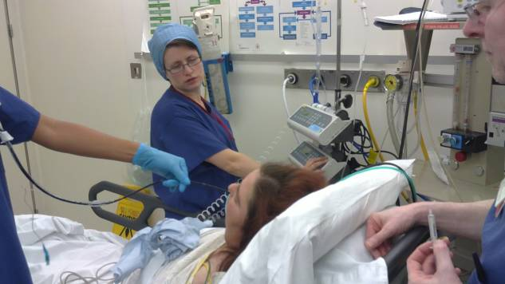
Factors contributing to failure of FOI Consequences
Lack of co-operation Hypoxia
Apnoea Cardiac arrest
Airway obstruction

Slide 21
Have a separate sedationist
Factors contributing to failure of FOI Consequences
Lack of co-operation Hypoxia
Apnoea Cardiac arrest
Airway obstruction
Reporters frequently suggested sedation had been poorly managed

Slide 22
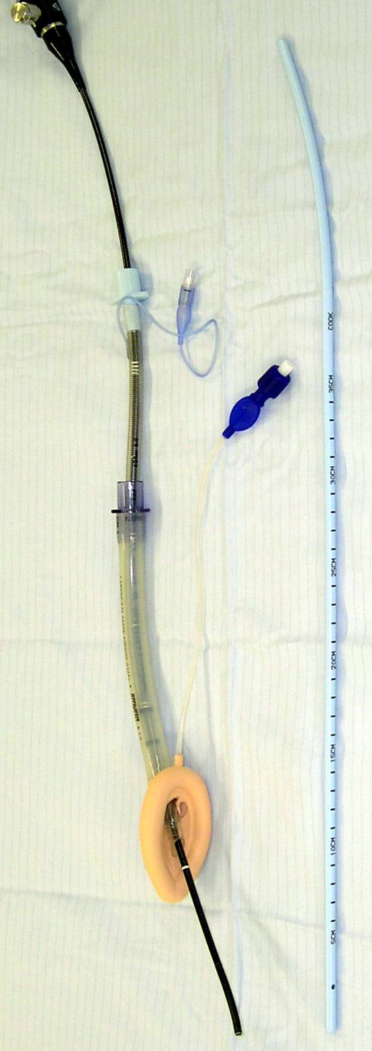
Healthy middle aged patient
Prolonged surgery under regional block
Failed intubation at conversion to GA
Easy ventilation via Supraglottic airway

Slide 23
Healthy middle aged patient
Prolonged surgery under regional block
Failed intubation at conversion to GA
Easy ventilation via Supraglottic airway
Needed post op IPPV on ICU
Intubation through the SAD not attempted
Tracheostomy!
All anaesthetists should learn low skill FOI

Slide 24
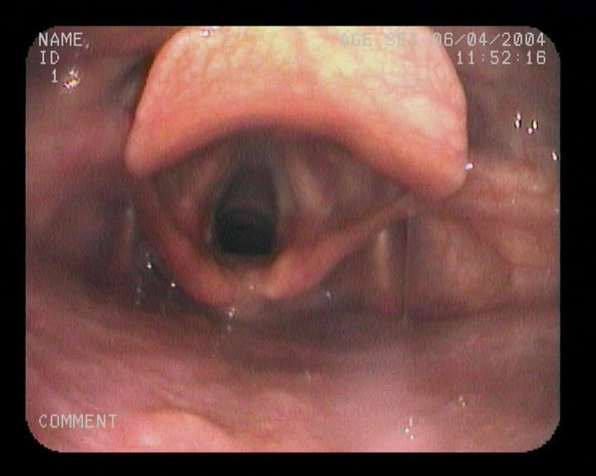
Hold up is a problem
2 cases where tube would not pass awake
Inducing general anaesthesia didn’t help and an emergency surgical airway was needed in both cases

Slide 25
Fibreoptic Intubation
Not always successful
We always need an airway strategy

Slide 26
Fibreoptic Intubation “At a glance”
Decrease threshold for FOI
Service should always be available
Intubation through SAD skills
Do FOI awake not asleep
Only induce GA after the tube is in
Have a separate sedationist
Always have a plan B (and C & D)

